Slide 1
Group 13
VDP1 Concept Designs

Slide 2
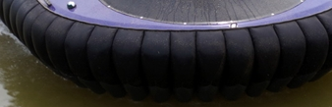
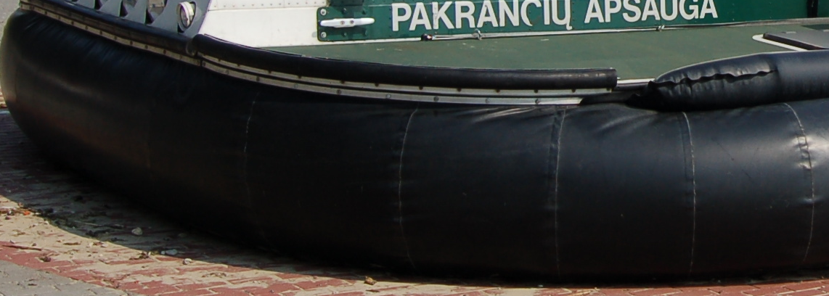
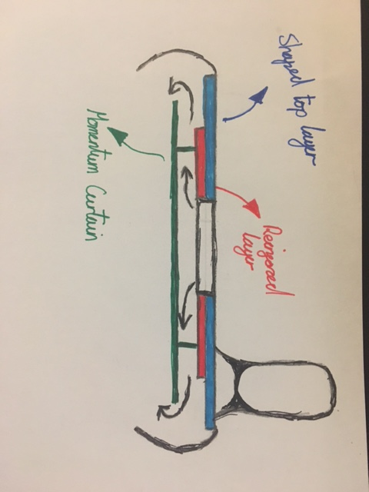
Chassis and Skirt
Chassis Engineer - Bradley Blocksidge
Skirt
Finger
Wall
The are two main types of skirt.
Wall skirt- Easy to build, lighter, cheaper
Finger Skirt-Good at going over obstacles, good for high speeds, smoother ride.
Body
Hovercraft Shape- There are two main hovercraft shapes that are predominantly used. Tear drop and rounded square shapes will most likely be the one we choose.
Size- Can only be 420 × 297mm in size. From one of side of the inflated craft to the other.
Reinforcement-The hovercraft needs to be light. If we make the body of the craft out of a single piece of light weight material it will likely bend and possibly break. To counter this a reinforcement layer could be added.
Hovercraft lift
Momentum curtain- Higher pressure air under the hovercraft as less air leaked out the sides. Meaning the craft lifts higher. Open plenum- No added material so the craft will be lighter and the hovercraft will be easier to build.

Slide 3
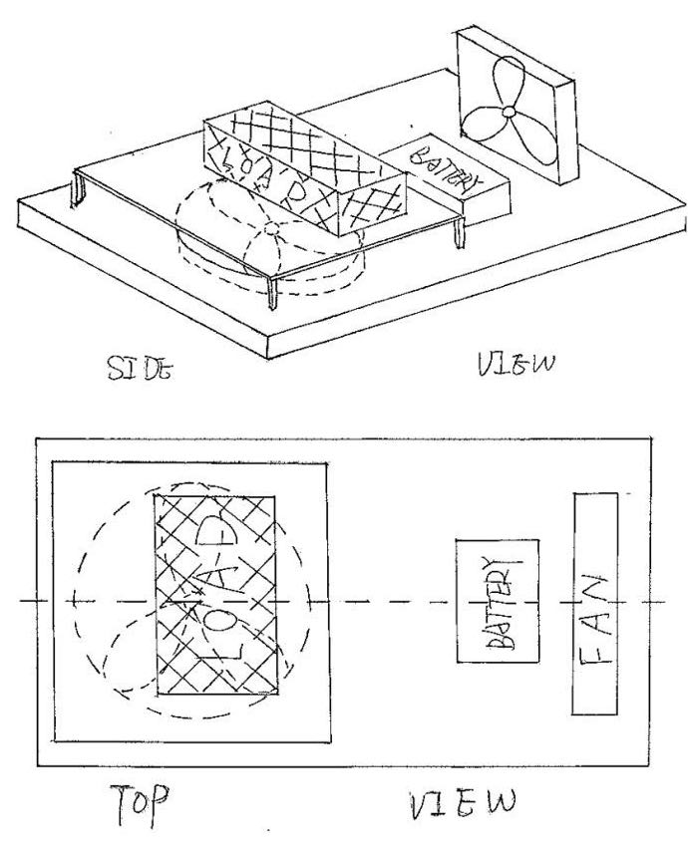
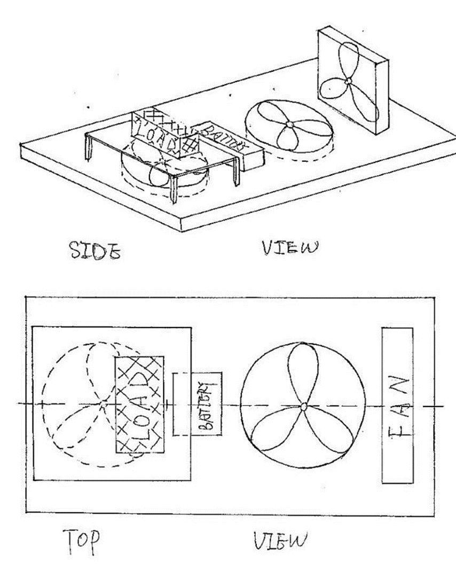
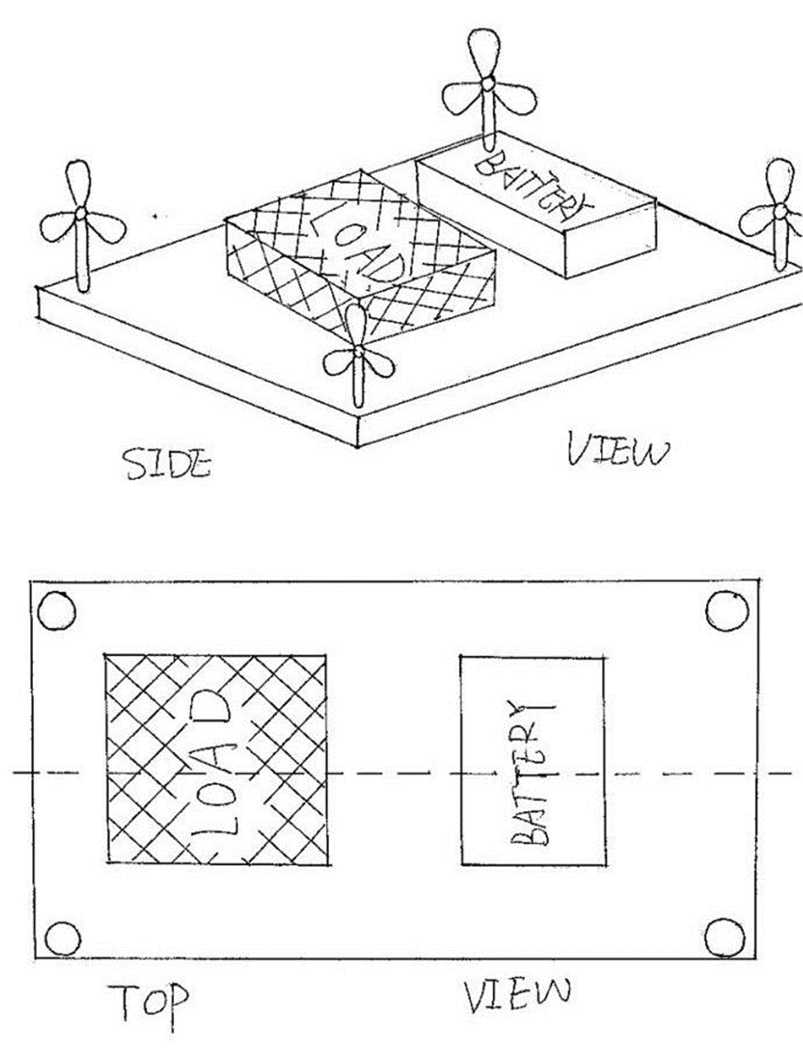
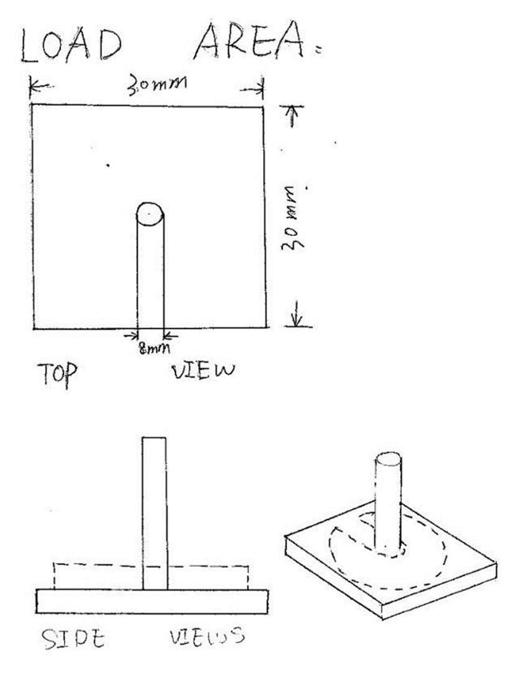
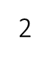

1
Payload Engineer – Xiang Zhang
Payload
There are two fans in 1 Both of the lift and propulsion are in the same size
Two lifts and one propulsion are in 2
Two lift should be in the same size
Four small propulsion fans are in the corner of the hovercraft in 3
Easy to put the mass on
Help to control the balance when put the mass on
All of the apparatus in this area should be symmetrical as much as possible to control the balance.
All of the dimensions should be measured for the balance test.

Slide 4
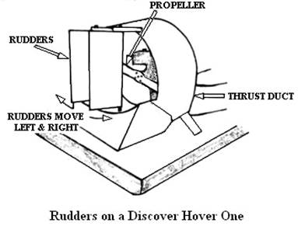
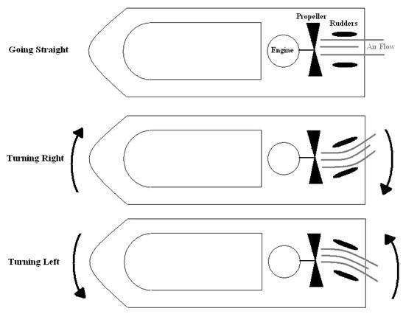
Turning of a Hovercraft
Integration Engineer - Paul Longe
Additional thrust fans
Rudders
Bow Thruster
Servomechanism rotating fan
Thrust fans can be turned off
Reduces affects from moment of inertia
Needs powerful lift fans
Additional Tubing
Harder to manufacture
Liable to effects from moment of inertia
High radius of turn
More air redirected, smaller radius
Smaller radius requires more and better designed rudders
Works when coasting
To Scale model of course
More flexibility in design
Greater thrust
Expensive
More wires required
Uses up more power
Requirements
A hovercraft of max size 297x420mm must be capable of completing a 180° turn within a minimum area of 1x1.2m.
The hovercraft needs to manoeuvre within a 2.4x1.2 meter area.
The hovercraft needs to be able to overcome obstacles of maximum height 5mm, if they can not be overcome by lift, the hovercraft needs to be able to avoid them through manoeuvers.
More precise in angle of control
Control speed of rotation
Always needs thrust applied
More complex
Liable to effects from moment of inertia
Imprecise control
Hover Craft
Turning area
Obstacle Area
Start/Finish

Slide 5
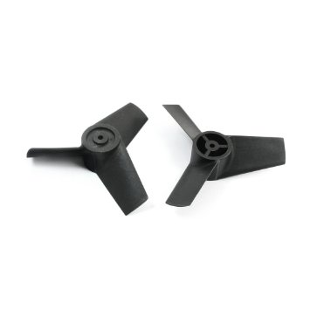
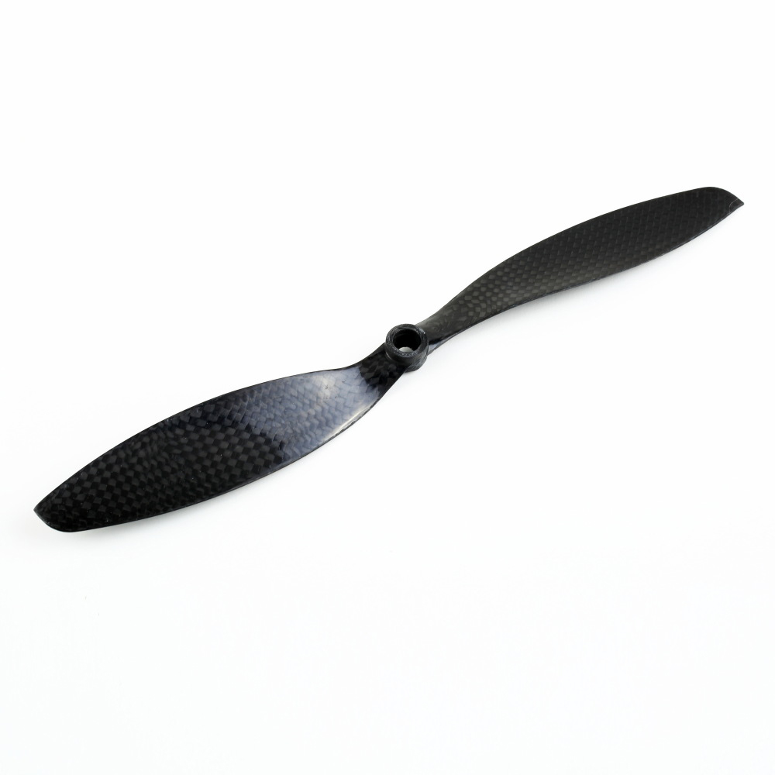
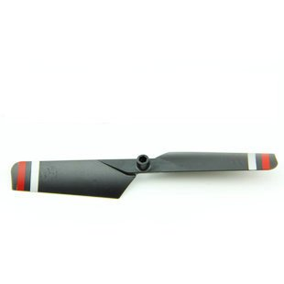
Design Engineer – Alexandros Iakovos Agrafiotis
Rotors, Fans & Materials
Low in cost
Extra Energy
More Power
Less efficient
Less space requires
Low weight (plastic)
Materials & Cost
Materials | Thickness | Cost
Aluminium sheet | 0.9mm | £11/m²
MDF | 3.6mm | £3/m²
Carbon Fiber | 0.75mm | £61.15/300mm x 300mm x 0.75mm
Craftfoam Blue | 25mm | £12/m²
Low in cost
More thrust because of the length of blades
More efficient
More space requires
Low weight ( Carbon )
Low in cost
More thrust because of the length of blades
More efficient and power-full
More space requires
Low weight ( plastic )
For the main body of the hovercraft I would recommend Craftfoam Blue as it is very light material with Aluminium sheet in order not to brake from the load.

Slide 6
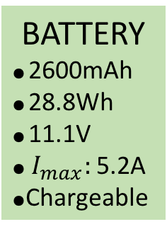
Powertrain Engineer – Keqi Shu
Motors & Batteries
Close-loop control, stability, high speed
change, steady torque
servo motor
£8.90
Comparatively expensive
Motion
Motor
Cheap, Open-loop control
Stepper Motor
£2.00
Small torque
BATTERY
● 2600mAh
● 28.8Wh
● 11.1V
● $I_{max}:$ 5.2A
●Chargeable
Easy to control, direct force
on the liner direction
DC Linear
Actuator Motor
Expensive, hard to apply on motion control
£21.71
Low energy cost, low electrical interference,
Stable, accurate and controllable rotate speed
Brushless motor
Load
Motor
£24.33
Expensive
Budget
z
Cheap, stable rotate speed,
Brushed motor
Power
Very low
Produce heat, low efficiency,
low output power
Weight
Other
Great torque, save space
DC Geared Motor
Stability
£19.99
High cost, low rotating speed

Slide 7
Electrical and Systems Engineer – Divine Abraham
The Hovercraft will need either 2 Electronics Speed Controllers, one for the Lift & one for Thrust (Total of £8) or a Dual DC motor driver board (£3.74+)
Specification: | Electronics Speed Controllers | Dual DC motor driver board
Control Speed | Pulse Width Modulation | Pulse Width Modulation
Brake | Yes | No
Low Voltage Protection Threshold | Yes | No
Over-heat protection: | Yes | No
Throttle signal loss protection | Yes | No
8 x 1.5V AA battery
Radio Transmitter
(12V)
Hovercraft
Dual DC motor driver board
Receiver
OR
Motor for Lift
Electronic Speed Controller
6V input
Motor for Forward Thrust
Li-Ion Battery
2600mAh, 11.1V

